Slide 1
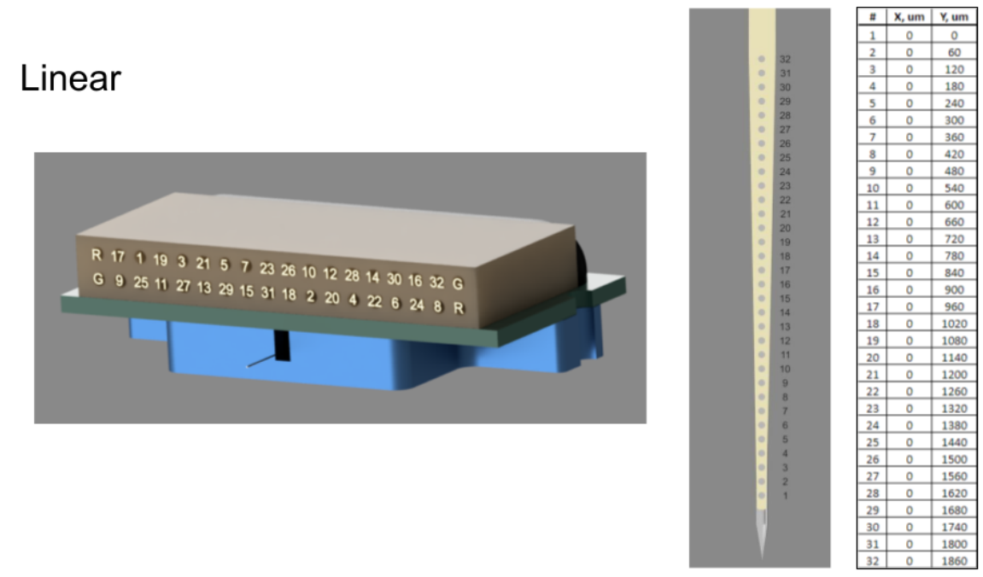
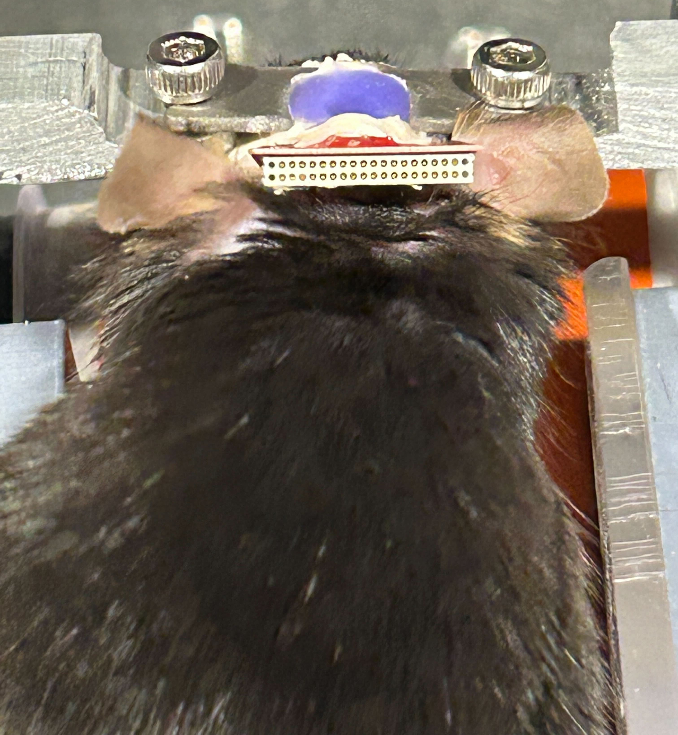

Slide 2
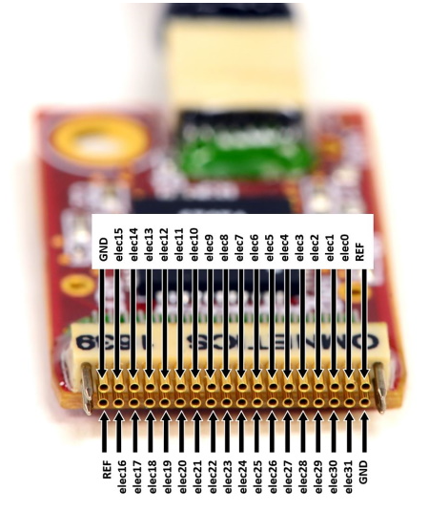
Connect Intan elec0 to Omnetics 8
Assuming Omnetics 1839 label on Intan front end faces forward

